Slide 1
Interview with AI
- Mohammed Saalim K

Slide 2
Introduction
Fed up with automated rejection emails? Our product doesn’t solve that but at least works on solving it.
The goal of the product is to provide personalized feedbacks for every candidate which will not be ideal in a human based interview. Leveraging the power of AI to avoid biased, unsatisfactory interview processes and help us improve with providing us feedbacks on the areas we can improve and also, knowing where we excel.

Slide 3
Backend
We have worked on both Traditional approaches and used AI to evaluate candidate’s answers.
1) Weak AI
- I have multiple NLP pretrained models like wordnet, transformers etc to find the semantic similarity. Accuracy was low
2) Open AI
- Integrated with chatgpt3.5 to evaluate candidate’s answer and provide us with a score ranging from 0 to 1. It’s able to give feedback and accuracy is higher.

Slide 4
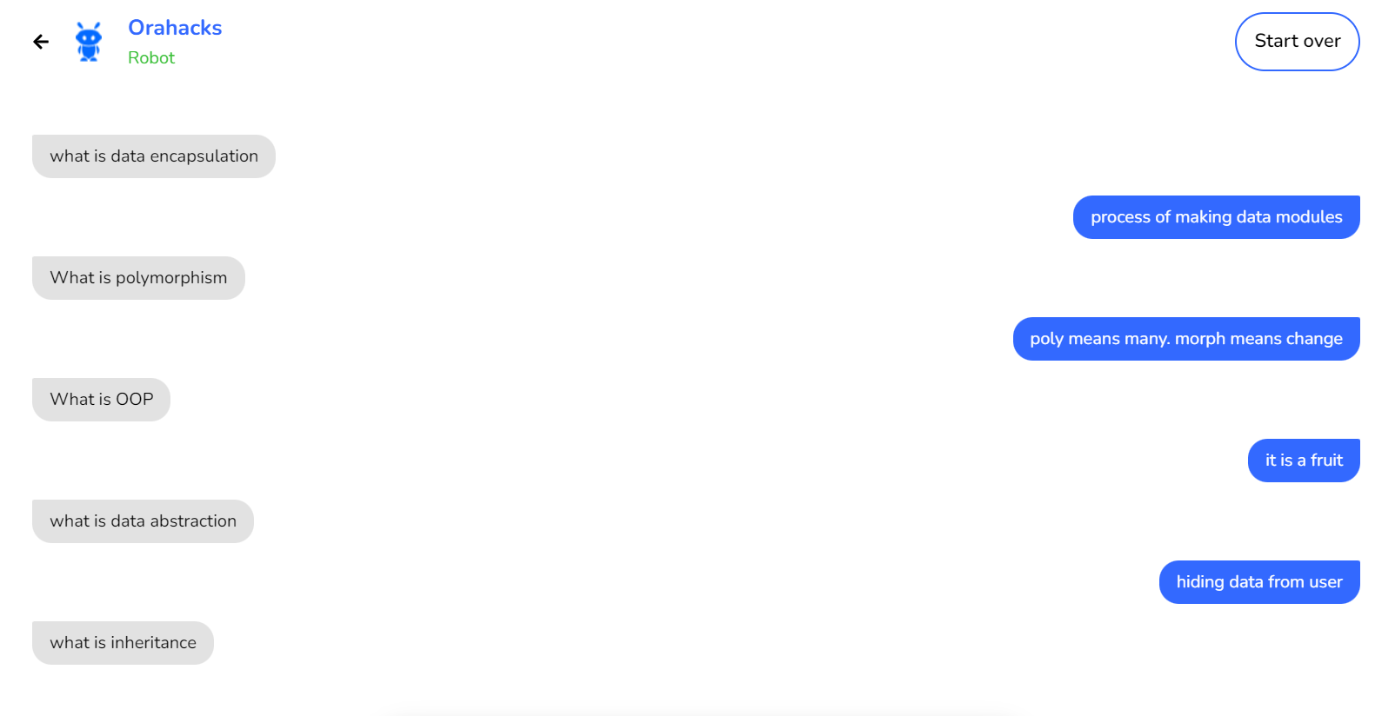
User Interface

Slide 5
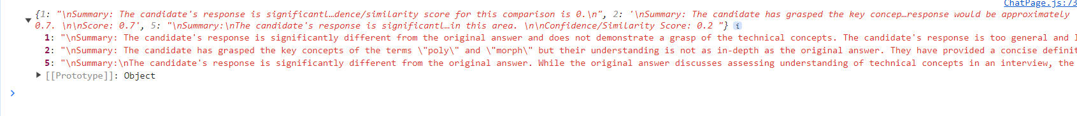
Response from Backend.

Slide 6
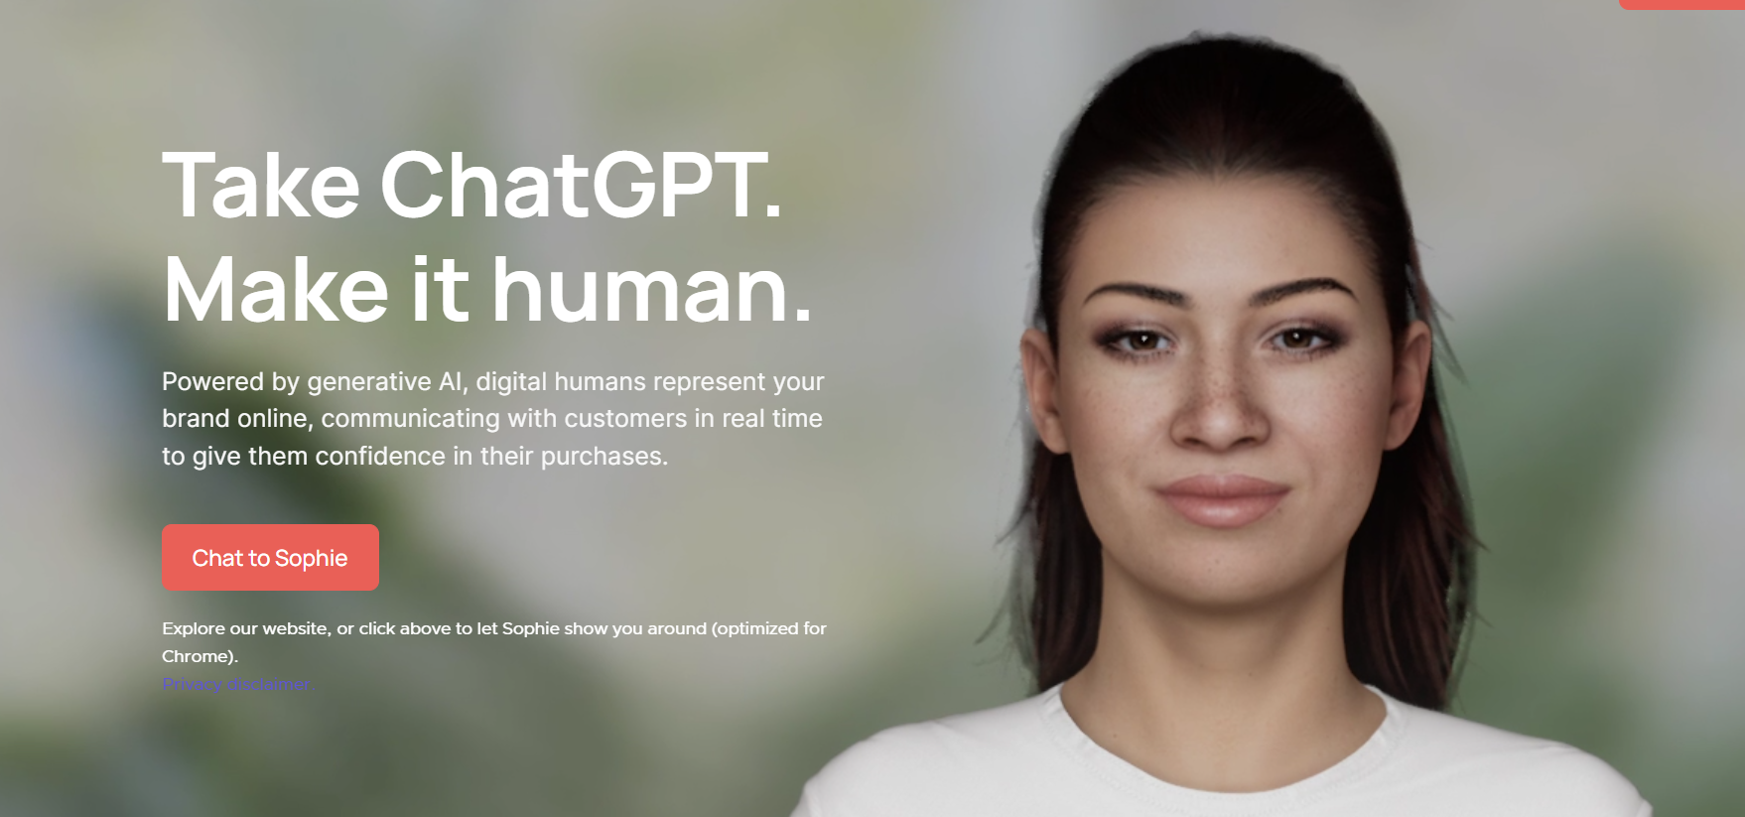
Future Works
We can integrate with 3rd party APIs for providing a simulation on AI conducting interviews.
We can also configure the plugins to enable emotions displayed in the digital human.

Slide 7
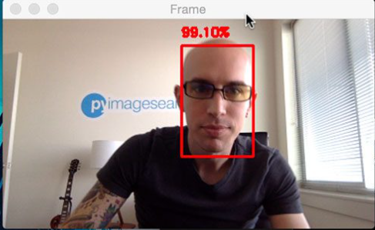
Future Works
We can utilize computer vision technologies to employ features like detecting confidence levels, body language using sentiment-analysis.

